Slide 1
Secure Data Hiding in Image Using Steganography
CAPSTONE PROJECT
Presented By: Kshitij Chandel
Student Name : Kshitij Chandel
College Name & Department : National Forensic Sciences University (CSE)

Slide 2
OUTLINE
Problem Statement
Technology used
Wow factor
End users
Result
Conclusion
Git-hub Link

Slide 3
Problem Statement
With the rise in cyber threats and data breaches, ensuring secure communication has become a challenge. Traditional encryption techniques make data transmission obvious, raising suspicion.
Steganography, a technique of hiding data within images, provides a secure and covert method of communication, minimizing detection risks.

Slide 4
Technology used
Programming Language: Python
Libraries: OpenCV, NumPy, Matplotlib, PIL (Pillow)
Platform: Jupyter Notebook / PyCharm / VS Code,

Slide 5
Wow factors
Enhanced Security: Data is hidden in an image, making it undetectable to unauthorized users
Minimal Data Loss: Image quality is nearly identical before and after embedding data.
User-Friendly Interface: Can be implemented with a simple GUI for ease of use.

Slide 6
End users
Government Agencies (for secure communication)
Journalists & Activists (to avoid surveillance)
Cybersecurity Experts
General Users (for personal data security)

Slide 7
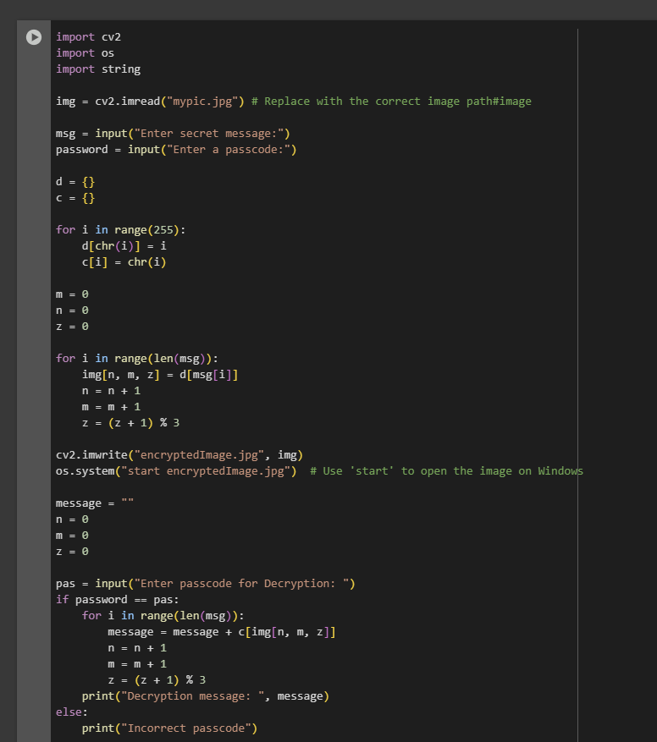
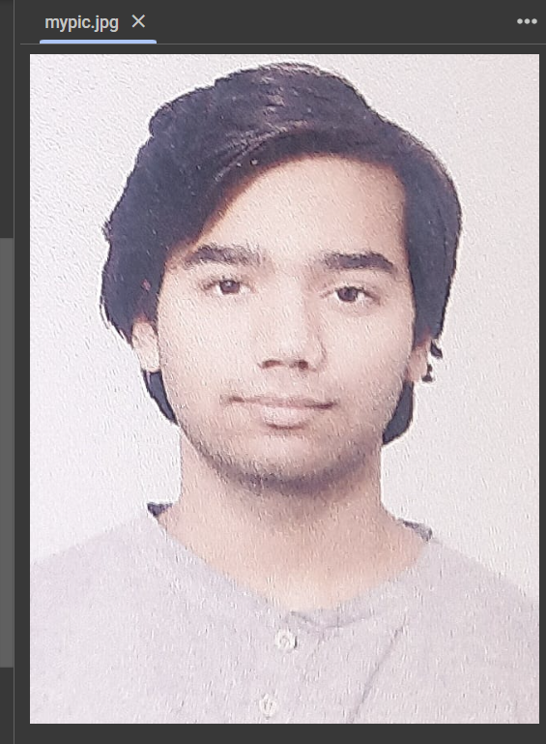
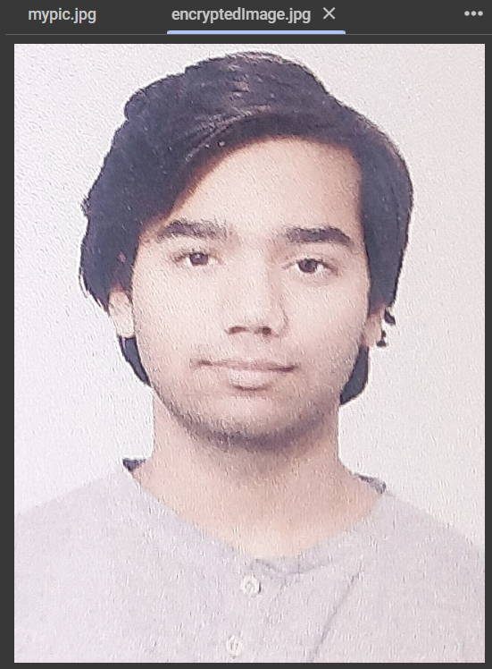
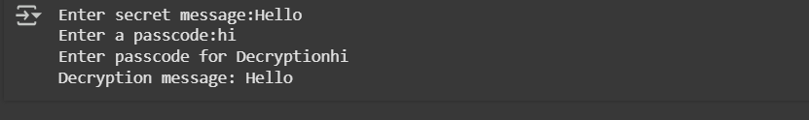
Results

Slide 8
Conclusion
This project successfully demonstrates the implementation of image steganography using a simple Python script and a library.
It allows secure data transmission without raising suspicion, making it a powerful tool for confidential communication. With advancements, it can be integrated with AI for automatic detection and optimization.

Slide 9
GitHub Link
https://github.com/real-horizon02/Steganography-Project

Slide 10
THANK YOU

